Slide 1
Chapter 2
Content Delivery Networks (CDNs)

Slide 2

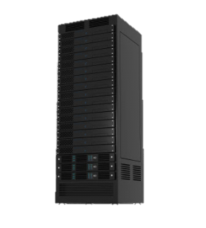
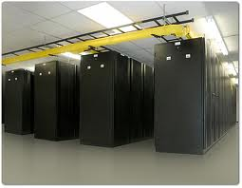
Client side data: Caching
Problem
HTTP is stateless
Resending server data wastes bandwidth
Caching
Save previously delivered data
Subsequent requests served from cache on the browser, or in the access network
Applications
Reduce response time for client request
Reduce ISP traffic costs
Content distribution networks
Distributed caches
Web objects addressed to CDN server
CDN server fetches from content provider on first access
GET index.htm
GET
Client
OK
Cache
Server
Conditional GET
Cache: specify date of cached copy in HTTP request If-modified-since: <date>
Server: response contains no object if cached copy is up-to-date: HTTP/1.0 304 Not Modified
Why is sending a conditional GET all the way to the server still faster, than a non-conditional GET?

Slide 3

Content delivery networks (CDNs)
Challenge:
How to stream content to millions of users?
Option 1:
Single mega-datacenter
Pros: Simple
Cons:
Single point of failure
Point of network congestion
Long path to distant clients
Multiple copies of video sent over outgoing link

Slide 4
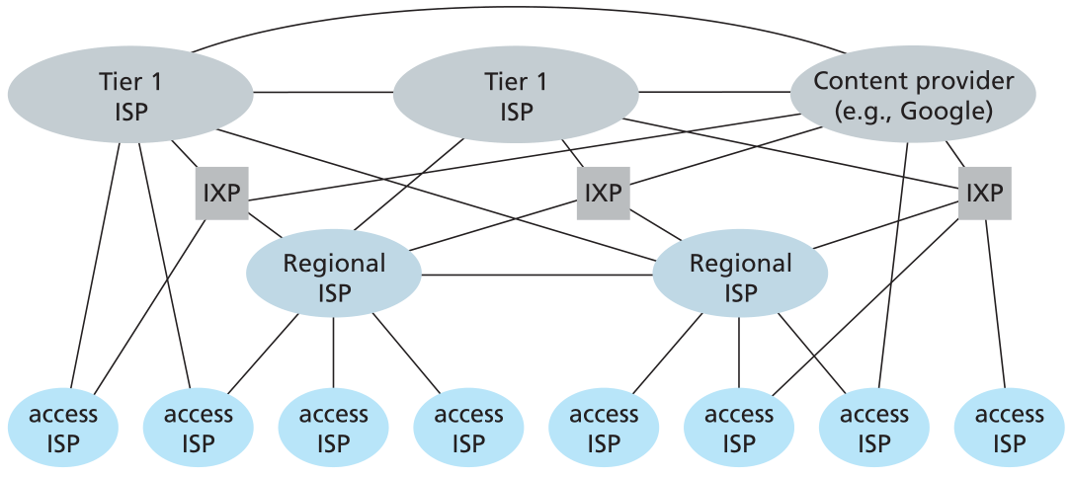



Content delivery networks (CDNs)
Option 2:
Store/serve multiple copies of videos at multiple geographically distributed sites
Enter deep: push CDN servers deep into many access networks
Close to users
Used by Akamai, 1700 locations
Bring home: smaller number (10’s) of larger clusters in POPs near (but not within) access networks
Used by Limelight
P2P: stream data from clients themselves
Based on BitTorrent (not really a CDN)
Used by Kankan (in China)
CDNs have limited impact on dynamic content. Why?
Notes:
What does Google do?
- both, also mention private networks, which is why it’s faster than bing

Slide 5




Content delivery networks (CDNs)
Option 2:
Store/serve multiple copies of videos at multiple geographically distributed sites
Enter deep: push CDN servers deep into many access networks
Close to users
Used by Akamai, 1700 locations
Bring home: smaller number (10’s) of larger clusters in POPs near (but not within) access networks
Used by Limelight
P2P: stream data from clients themselves
Based on BitTorrent (not really a CDN)
Used by Kankan (in China)
Origin server
LDNS
http://profile.ak.fbcdn.net/ hprofile-ak-snc4/ 41671_1062307220_4094_q.jpg
[mwittie@esus ~]$ host profile.ak.fbcdn.net
profile.ak.fbcdn.net is an alias for profile.ak.facebook.com.edgesuite.net
profile.ak.facebook.com.edgesuite.net is an alias for a1725.l.akamai.net
a1725.l.akamai.net has address 92.122.50.192
a1725.l.akamai.net has address 92.122.50.184
a1725.l.akamai.net has address 92.122.50.162
a1725.l.akamai.net has address 92.122.50.147
Notes:
What does Google do?
- both, also mention private networks, which is why it’s faster than bing

Slide 6
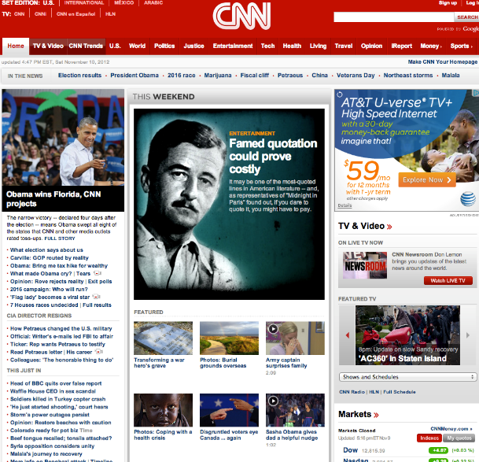




Ubiquity of CDNs
34 DNS lookups
204 HTTP requests
520 KB of data downloaded
56% of domains resolve to a CDN

Slide 7
CDN cluster selection strategy
Challenge: how does CDN DNS select “good” CDN node to stream to client
Pick CDN node geographically closest to client’s local DNS
Pick CDN node with shortest delay (or min # hops) to client (CDN nodes periodically ping access ISPs, reporting results to CDN DNS)
IP anycast – have routers choose shortest path to replicas advertised under the same IP address

Slide 8

Domain Name System (DNS)
People like names
Ex. montana.edu
Routers like fixed width addresses
Ex. 153.90.2.87 (32 bits)
How to map between the two?
Domain Name System:
Database of mappings between host names and IP addresses
Application layer protocol
Hosts communicate with DNS to resolve names
Lookups over UDP on port 53
Example:
Authoritative DNS
Client
LDNS
montana.edu
???
DNS lookup
153.90.2.87
What if the LDNS is far from the Client?

Slide 9
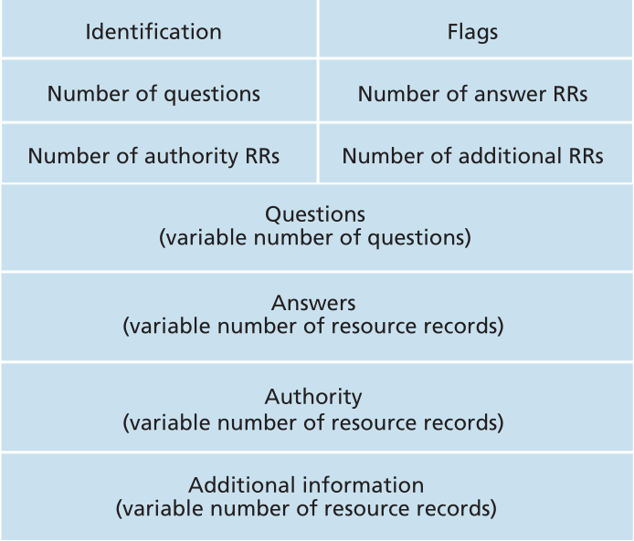
Extension mechanisms for DNS
Idea
Avoid impact of remote DNS by changing localization approach
Directly provide client location to CDN
Implemented as an EDNS0 extension
DNS resolver adds client’s IP prefix to request
Approximate client location approach typically sufficient
/16 prefix enough for Google and EdgeCast CDNs
;; OPT PSEUDOSECTION: ; EDNS: version: 0, prefix: 128.111/16
Notes:
Downsides:
In practice, difficulties can arise when using EDNS traversing firewalls, since some firewalls assume a maximum DNS message length of 512 bytes and block longer DNS packets.
The introduction of EDNS made a type of Reflected Denial-of-Service attacks called DNS amplification feasible, since EDNS facilitates very large response packets compared to relatively small request packets.

Slide 10
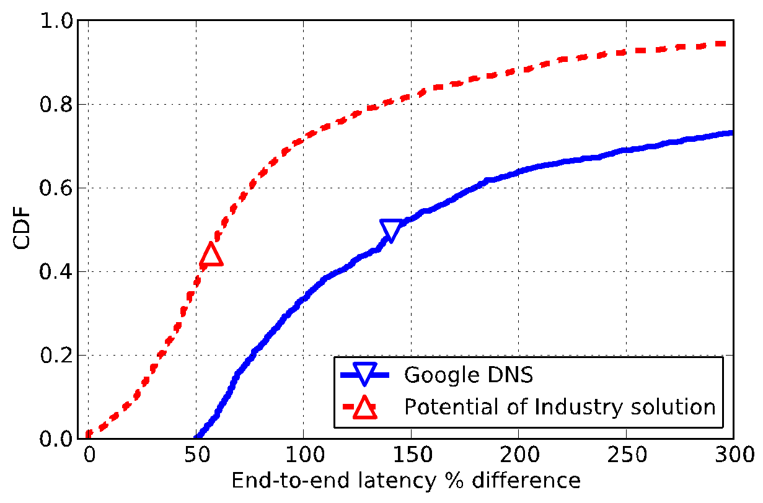
Evaluating the DNS extension
Focus on places where remote DNS affects performance
45% performance improvement

Slide 11
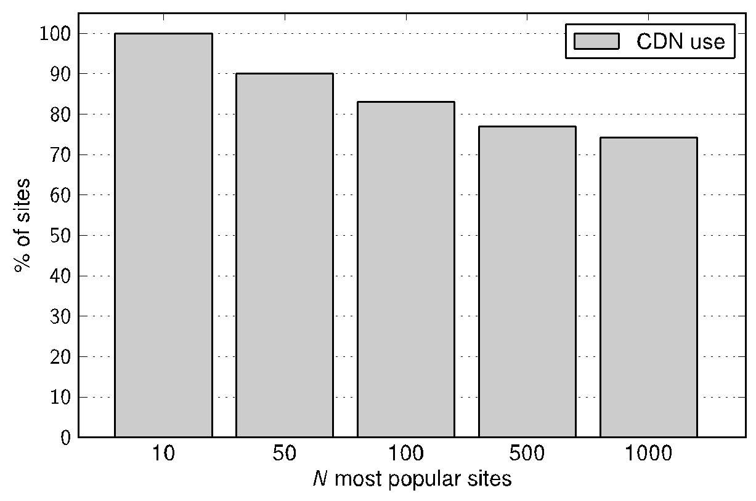
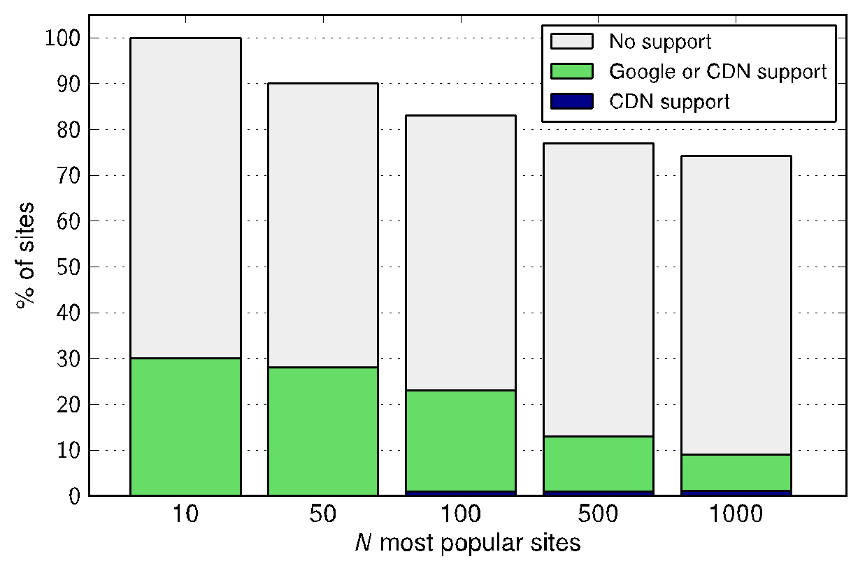
DNS extension adoption
Minor issue – both DNS and CDN services must support it
Google service support
most sites don’t support it
Only 1% of sites use it for content
Most support seen for Google services

Slide 12
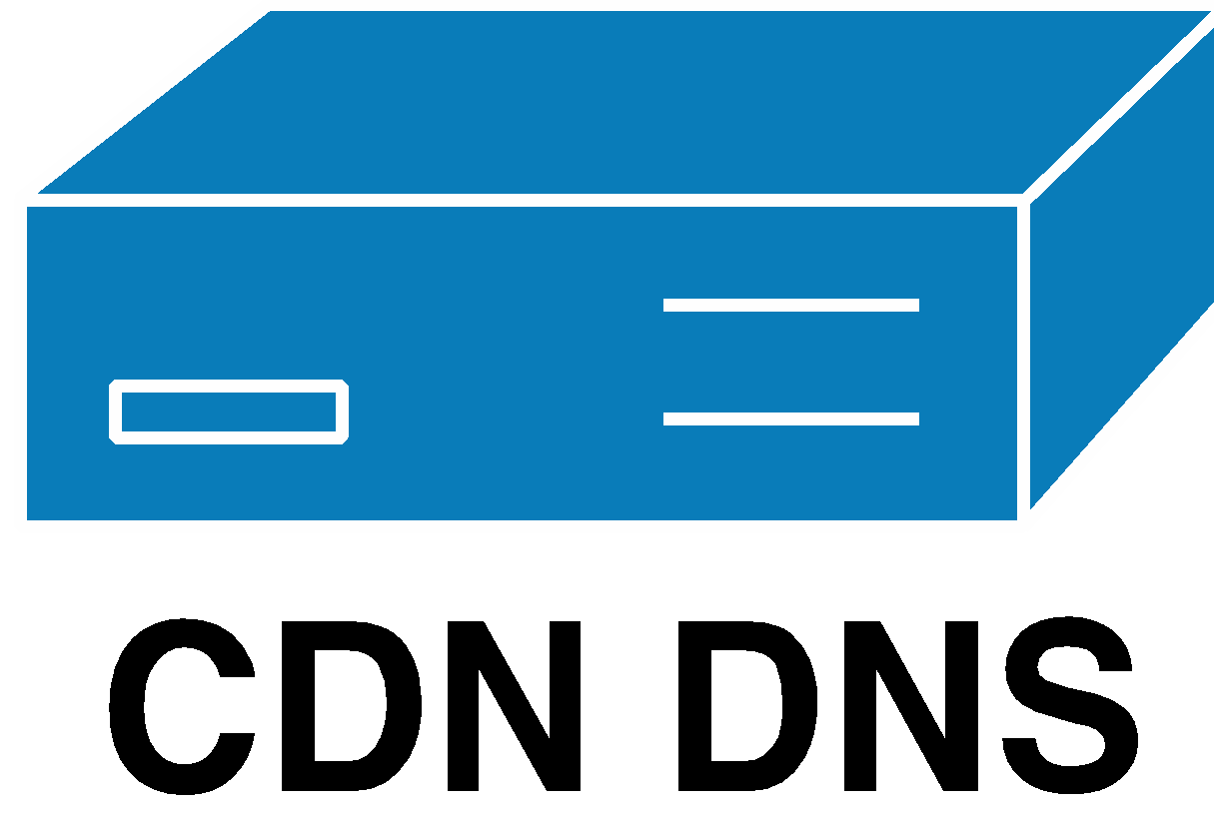
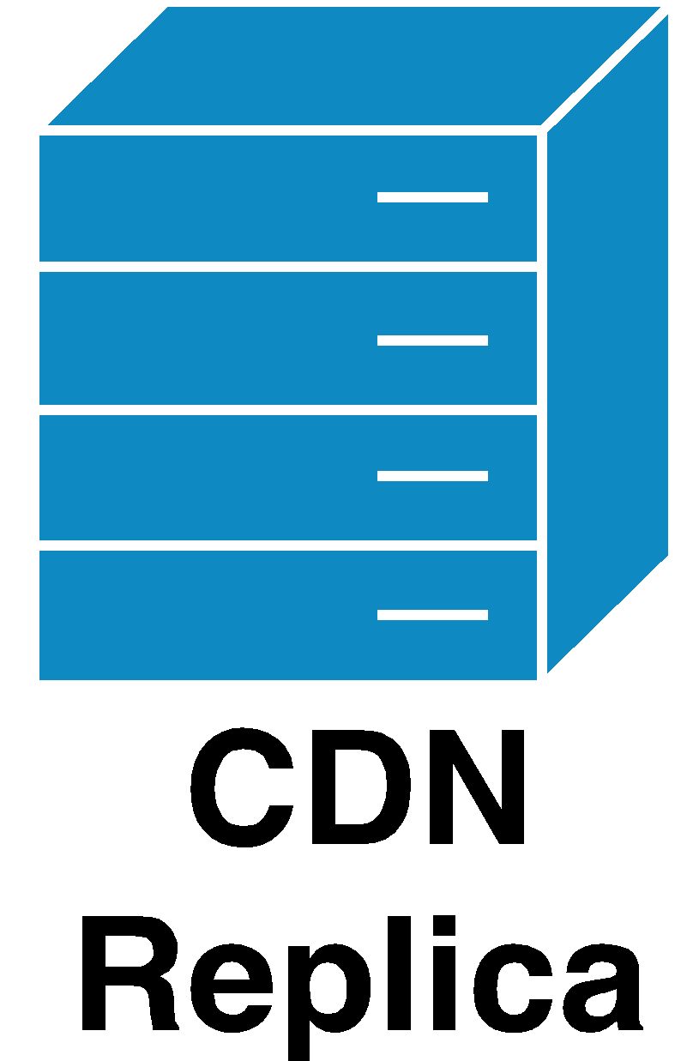


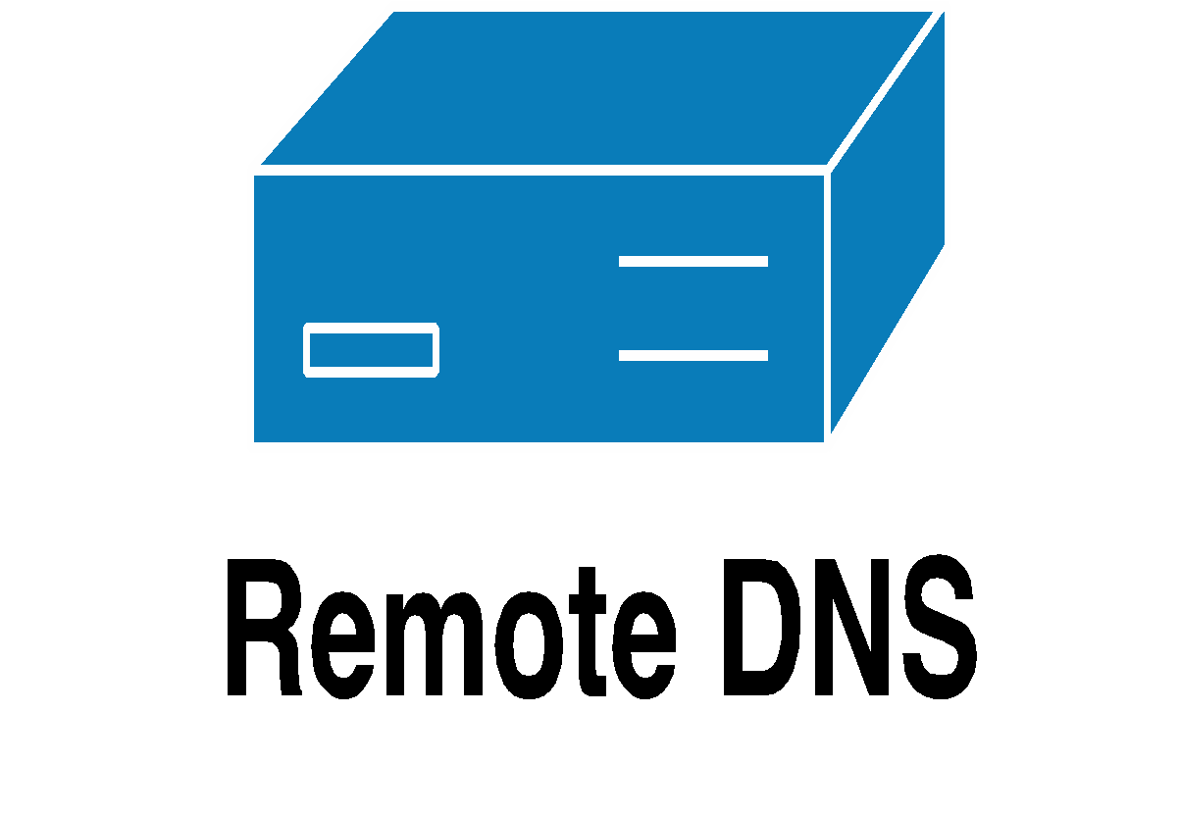
Direct Resolution approach
Step 1: typical DNS query to recursive resolver
Use recursive DNS to translate customer name to CDN
Step 2: directly query CDN for an improved redirection
DR
map
2
1
Initial
map

Slide 13
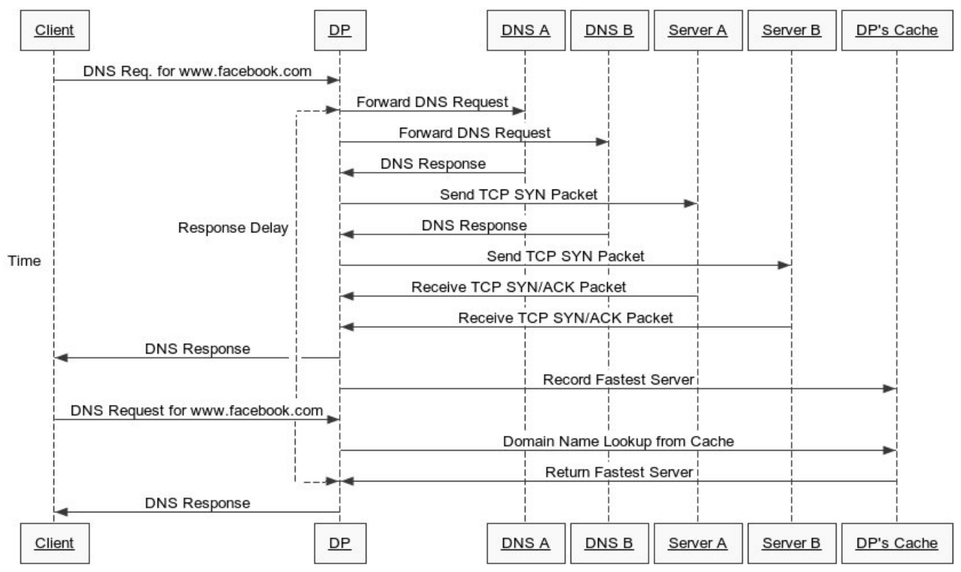
DNS proxy

Slide 14
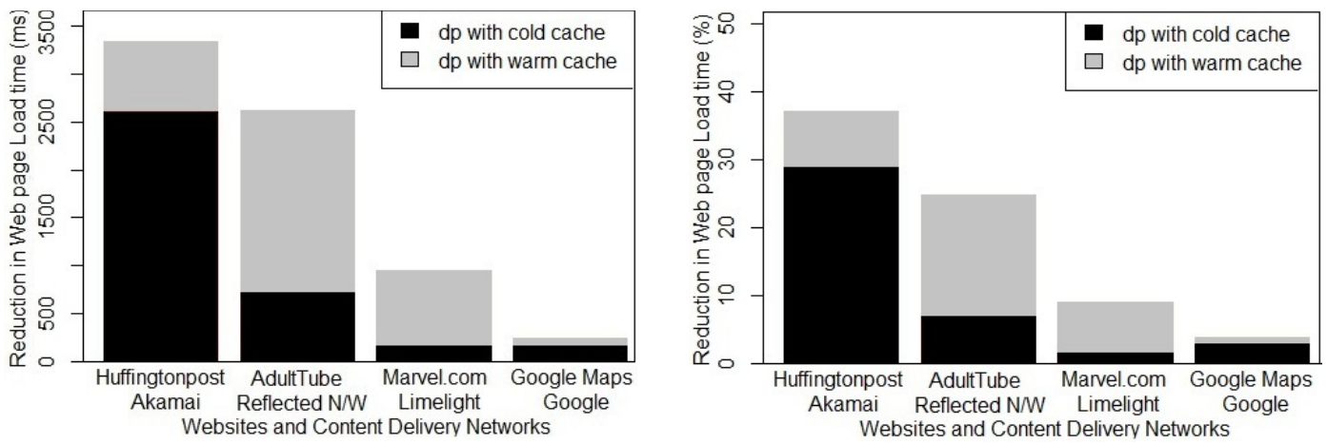
DNS proxy

Slide 15
Replica Selection
Given a set of datacenters, how to direct users to replicated logic and content?
Metrics:
Latency
Server load
Storage overhead
Inter-DC communication costs
Approaches to replica selection:
DNS IP-based
Client IP-based
IP anycast
Centralized logic

Slide 16

DNS redirection
http://profile.ak.fbcdn.net/hprofile-ak-snc4/41671_1062307220_4094_n.jpg
>host profile.ak.fbcdn.net
profile.ak.fbcdn.net is an alias for profile.ak.facebook.com.edgesuite.net.
profile.ak.facebook.com.edgesuite.net is an alias for a1725.dspl.akamai.net.
a1725.dspl.akamai.net has address 198.189.255.223
a1725.dspl.akamai.net has address 198.189.255.199
a1725.dspl.akamai.net has address 198.189.255.216
root DNS server
2
3
4
local DNS server
dns.montana.edu
5
6
1
8
7
How are these IP addresses determined?
authoritative DNS server
dns.fbcdn.net
requesting host
cs.montana.edu
profile.ak.fbcdn.net

Slide 17
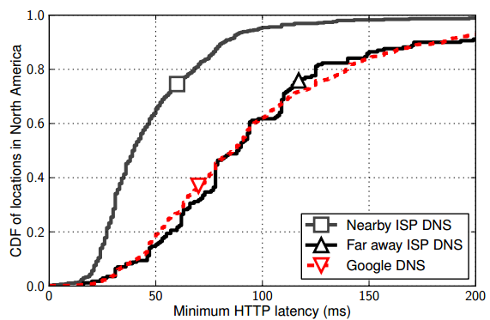
LDNS problem
Local DNS (LDNS) server close to user, CDN serve close to user
Content server
LDNS
Yay!
What happens when LDNS is not a good predictor of use location?
Why may LDNS be distance from a user?
Notes:
Public dns
Far off DNS > 50ms lat

Slide 18
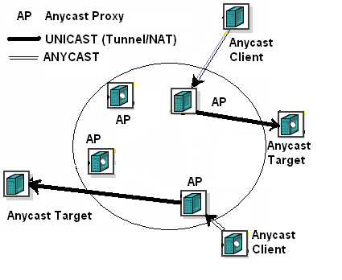
Anycast
AS 1 gets advertisements for IP address B from two eBGP announcements
AS 1
B
A
Path to B
AS 2
B

